Slide 1
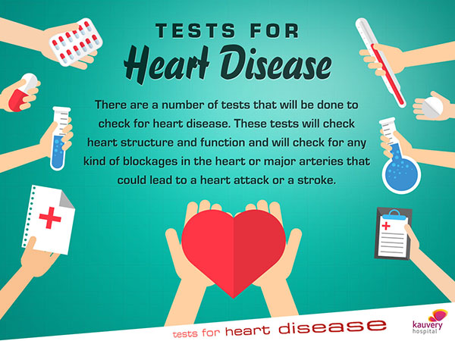
Heart disease prediction by machine learning
Several models applied by Elliott Cao

Slide 2
First stop – About Case Analyst
Data Scientist from Institute of Data (formerly as DSIA)
Master degrees with Health Informatics and Data Science
Bachelor degree with Financial Mathematics
Hobbies in Astronomy, Physics, Mathematics and Data Science

Slide 3
Case Outline
Part 0 – Dataset information
Part 1 – Data acquisition
Part 2 – Exploratory Data Analysis
Part 3 – Machine Learning models
Part 4 – Conclusion & Summary

Slide 4
Part 0 – Dataset information
Dataset name: heart.csv (Cleveland Heart disease - UCL and Kaggle)
Dataset size: 303 patients for total 14 specific attributes (columns)
Stakeholder: Victorian Cardiovascular Services (http://www.vcscardiology.com.au)

Slide 5
Part 0 – Dataset information
Agenda
How can we detect Heart Diseases fast and accurate?
Which model could be used to detect Heart Diseases with the most accurate and fast?

Slide 6
Purpose of selection
Use existing dataset to create a model that tries to predict if heart disease diagnosed or not.
Find out what factors caused heart diseases by using patients’ individual information.
Exact and compare what factors have significant impact on cardiovascular disease (CVD) by selecting one specific attribute, i.e., Age or Sex.
Neural Networks (optional) – trying to analyse model through Neural Networks.

Slide 7
Pythonic dictionary
age - the patient’s (Pt’s) age at admission
sex – the patient’s gender (1 = male, 0 = female)
cp - chest pain experienced (1 = typical angina, 2 = atypical angina, 3 = non-anginal, 4 = asymptomatic)
trestbps – the Pt’s resting blood pressure (mmHg)
chol – the Pt’s cholesterol in mg/dl
fbs – the fasting blood sugar (>120 mg/dl, 1 = true, 0 = false)
restecg – resting ECG (0 = normal, 1 = having ST-T wave abnormality, 2 = showing probable or definite left ventricular hypertrophy by Estes’ criteria)

Slide 8
Pythonic dictionary
thalach – the patient’s maximum heart rate achieved
exang – exercise induced angina (1 = yes, 0 = no)
oldpeak – ST depression induced by exercise relative to rest
slope – the slope of the peak exercise ST segment ( 1: upsloping, 2: flat, 3: downsloping)
ca – the number of major vessels (0~3)
thal – a blood disorder called thalassemia (3 = normal, 6 = fixed defect, 7 = reversable defect)
target – heart disease (0 = no, 1 = yes)

Slide 9
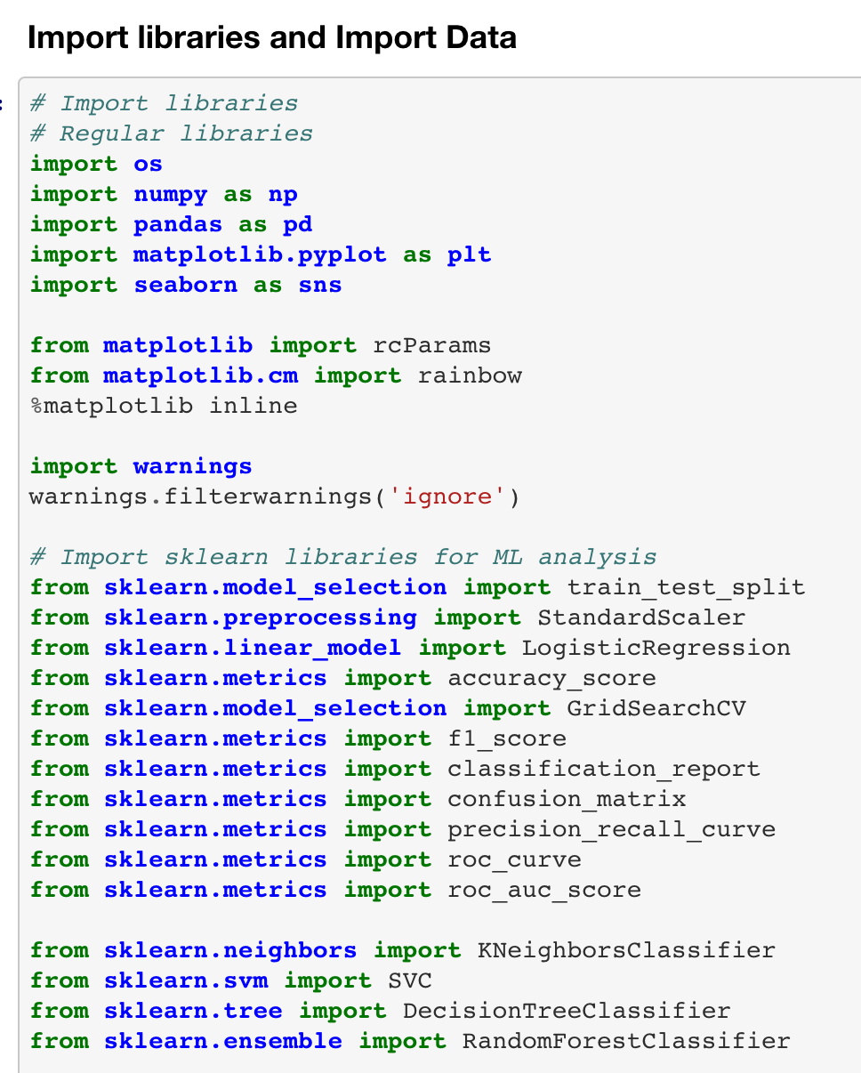
Part 1 – Data acquisition

Slide 10
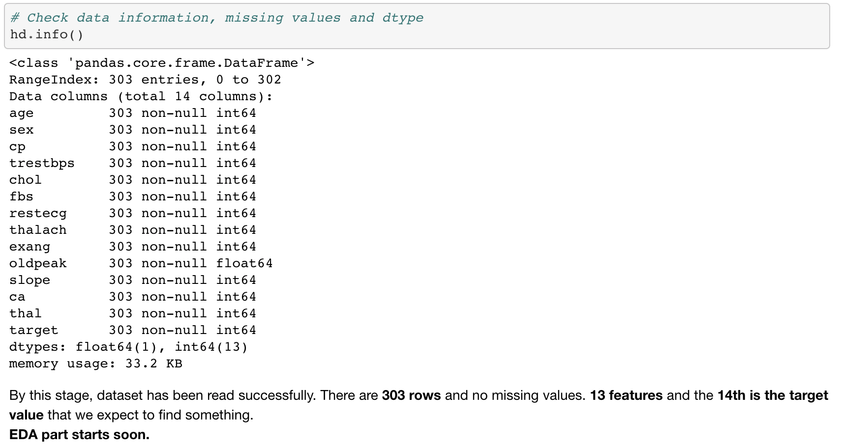
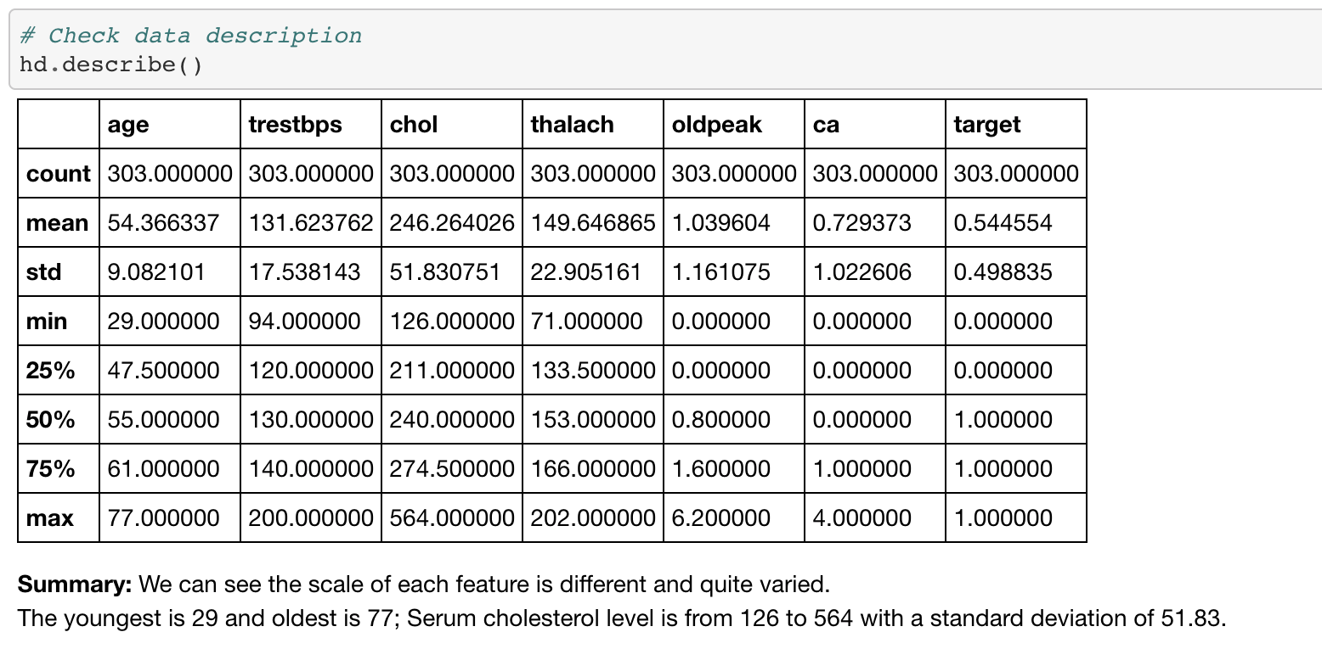
Part 2 – Exploratory Data Analysis

Slide 11
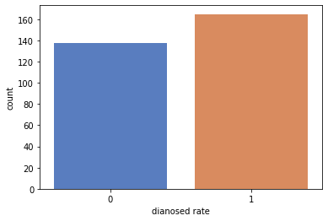
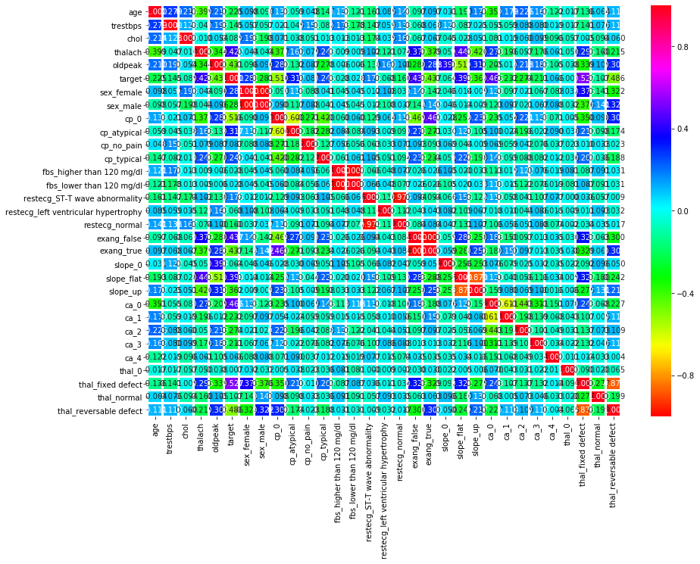
Part 2 – Exploratory Data Analysis

Slide 12
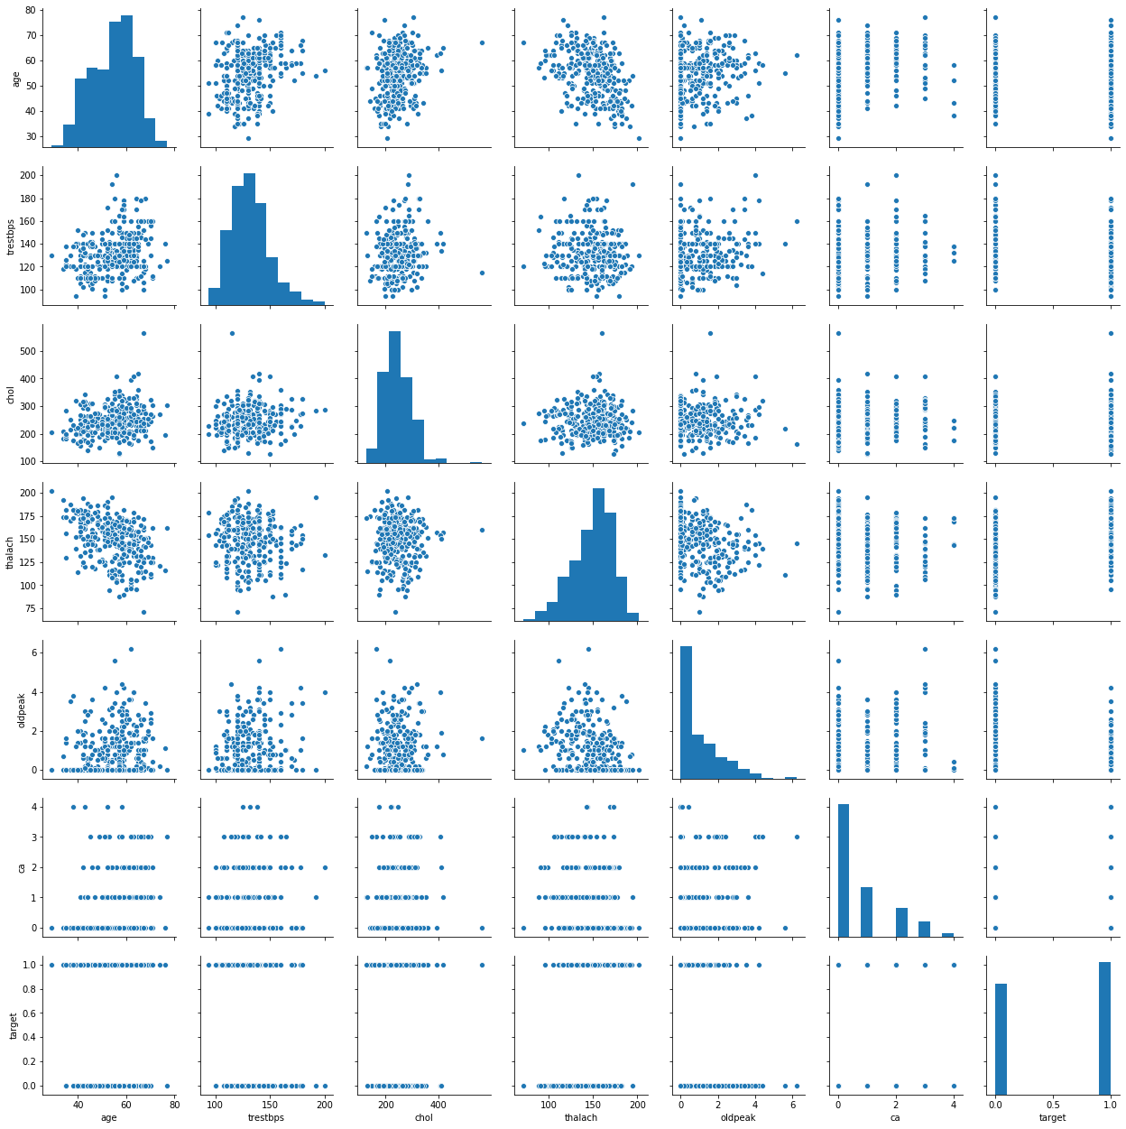
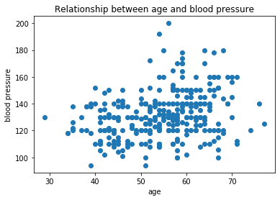

Slide 13
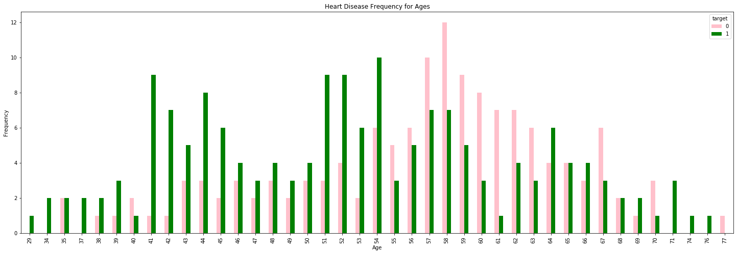
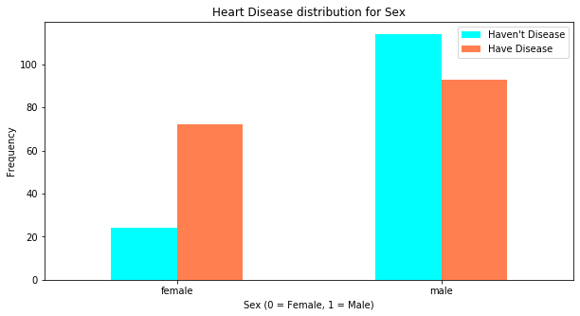

Slide 14
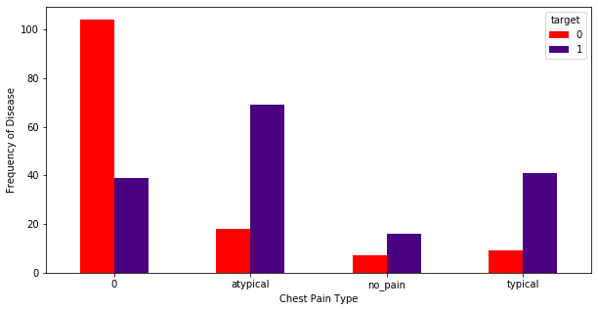
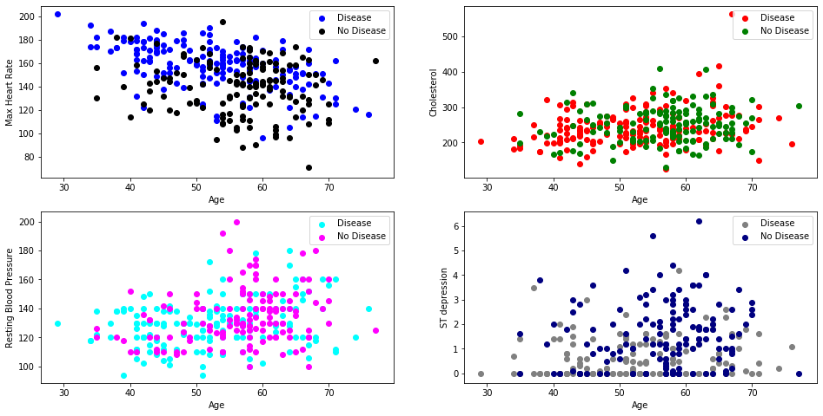

Slide 15
Part 3 – Machine Learning models
List of models used
KNN
SVM
Decision Tree
Random Forest
Logistic Regression
Neural Networks

Slide 16
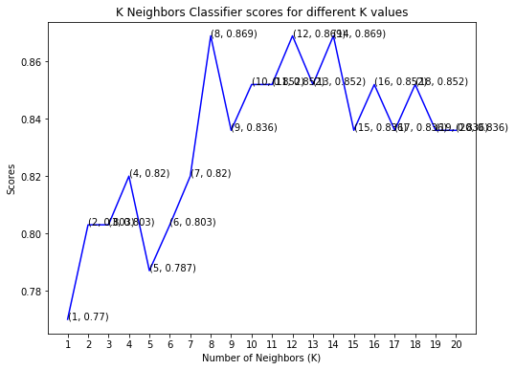
Part 3 – Machine Learning models
KNN

Slide 17
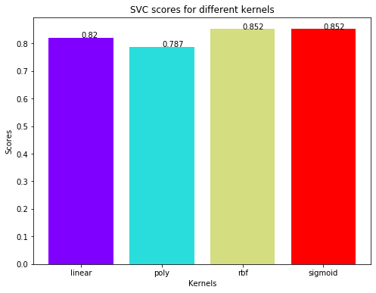
Part 3 – Machine Learning models
SVM

Slide 18
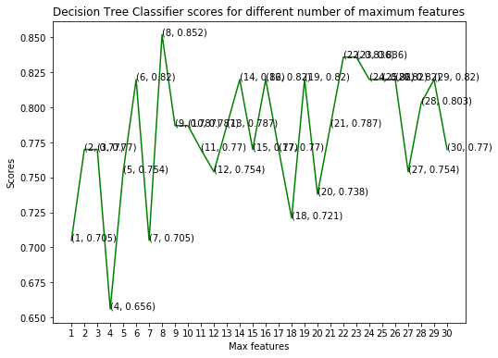
Part 3 – Machine Learning models
Decision Tree

Slide 19
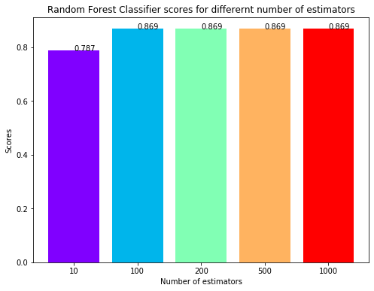
Part 3 – Machine Learning models
Random Forest

Slide 20
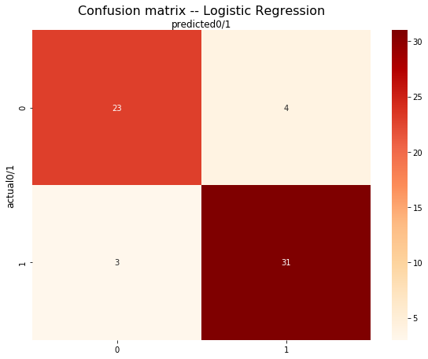
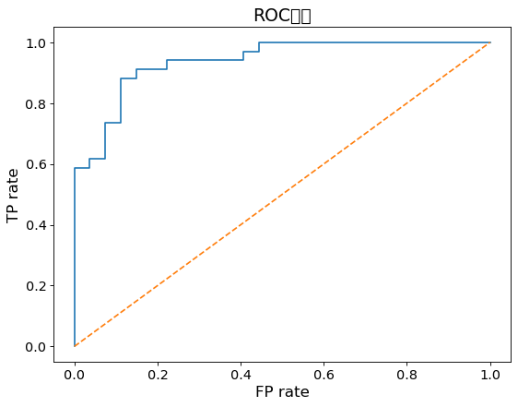
Part 3 – Machine Learning models
Logistic Regression

Slide 21
Part 4 – Conclusion & Summary
KNN: 86.9% with 8 neighbors (k=8,12,14)
SVM: 82.0% with linear kernel; 78.7% with poly kernel; 85.2% with rbf and sigmoid kernel
DT: 72.1% with [2,4,8]
RF: 78.7% at 10 and 86.9% after 100. (From original case, others found after 14, keeps 86.9%)
LR: roc 93.79% and f1 score 89.855%

Slide 22
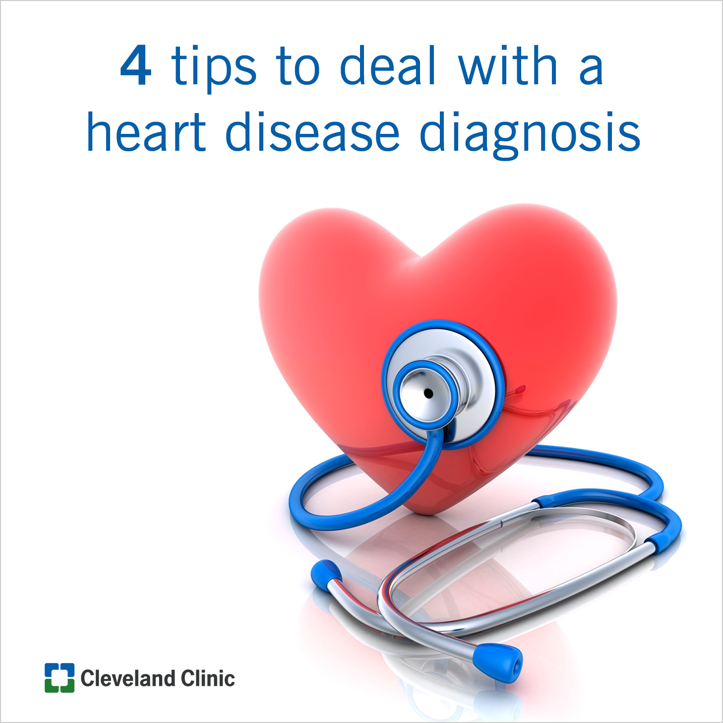
4 Tips for dealing with H.D. diagnosis from Cleveland Clinic
Ask your physician to explain your condition
Find out what caused your condition
Take immediate steps to correct contributing lifestyle factors
Tap into your support system
(Credit: Cleveland Clinic 2019)

Slide 23
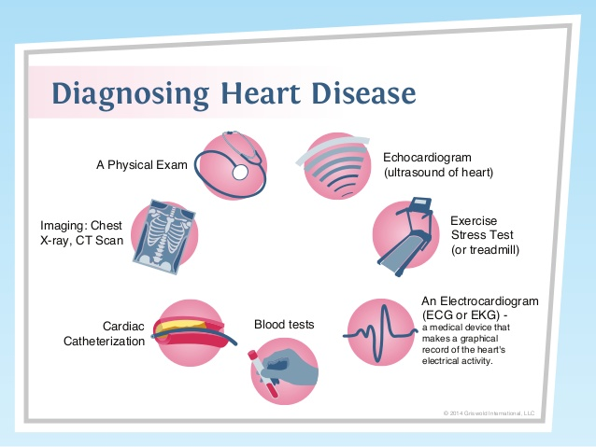
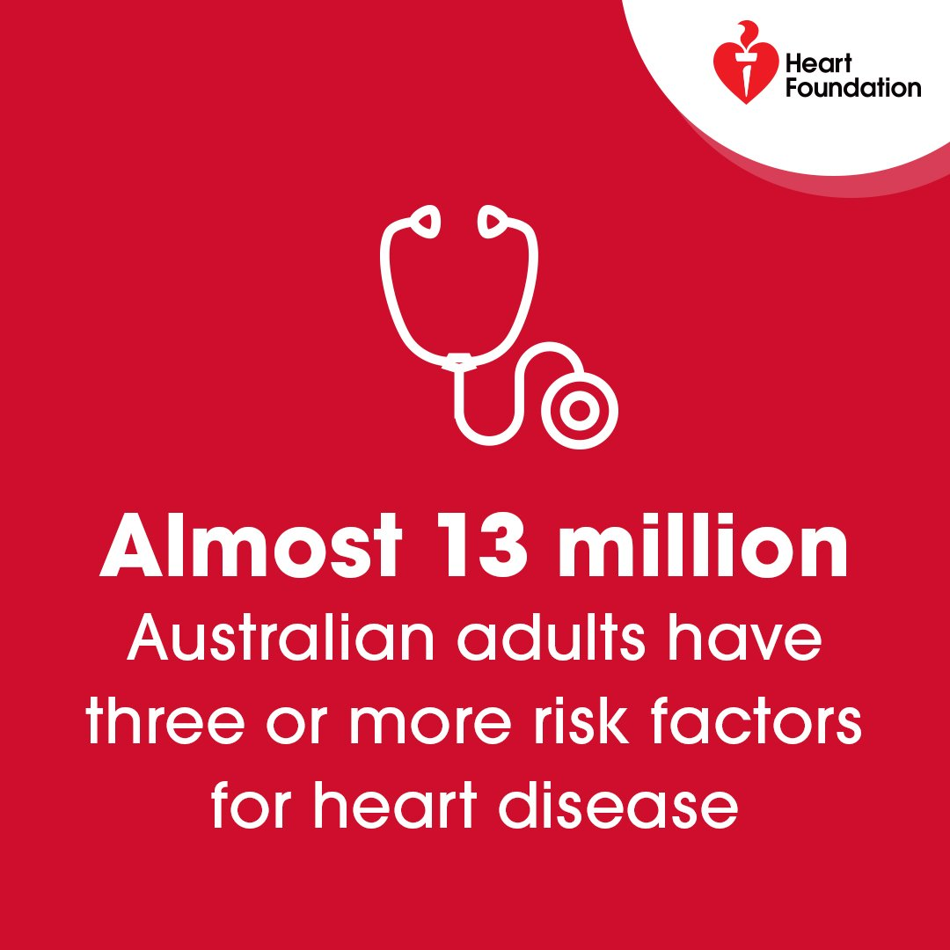
CVD Services in Australia
According to the Australia’s leading causes of death, 2018 from ABS
The rank 1 cause of death is still Ischaemic heart disease (IHD) since 2009 with 22,587, 2013 with 19,778 and 17,533 in 2018 (ABS).
Heart health checks covered by Medicare for patients over 45 yo and Indigenous from 30 yo.
~13m adult Australians are at risk of heart disease (The Senior).

Slide 24
References
Causes of Death, Australia, 2018. (2019). Retrieved from https://www.abs.gov.au/ausstats/abs@.nsf/mf/3303.0)
4 tips for dealing with heart disease diagnosis. (2019). Retrieved from https://health.clevelandclinic.org/4-tips-fo-dealing-with-heart-disease-diagnosis/
Heart health checks now covered by Medicare for over 45s. (2019). Retrieved from https://www.thesenior.com.au/story/6091995/two-in-three-adults-at-risk-of-heart-disease/
Heart disease. (2019). Retrieved from https://archive.ics.uci.edu/ml/datasets/heart+disease
Heart disease prediction with neural networks. (2019). Retrieved from https://www.kaggle.com/abdelsamad/heart-disease-predication-with-neural-networks/notebook
Victorian cardiovascular services. (2019). Retrieved from http://www.vcscardiology.com.au

